Slide 1
Deep Learning By MXK
Notes:
But before we do that, it's going to be helpful to dive into a bit of theory to
understand how computer vision works. Don't worry though: there will be very
little math, and understanding a bit about how computer vision works will help
us understand what can go wrong, and how to fix it.

Slide 2
Summary 1- Machine Learning Roadmap 2- Convolutional Neural Network 3- Microsoft Azure Example 4- Transfer Learning (VGG16) 6- gColab 7- Kahoot 8- Closing Thoughts

Slide 3
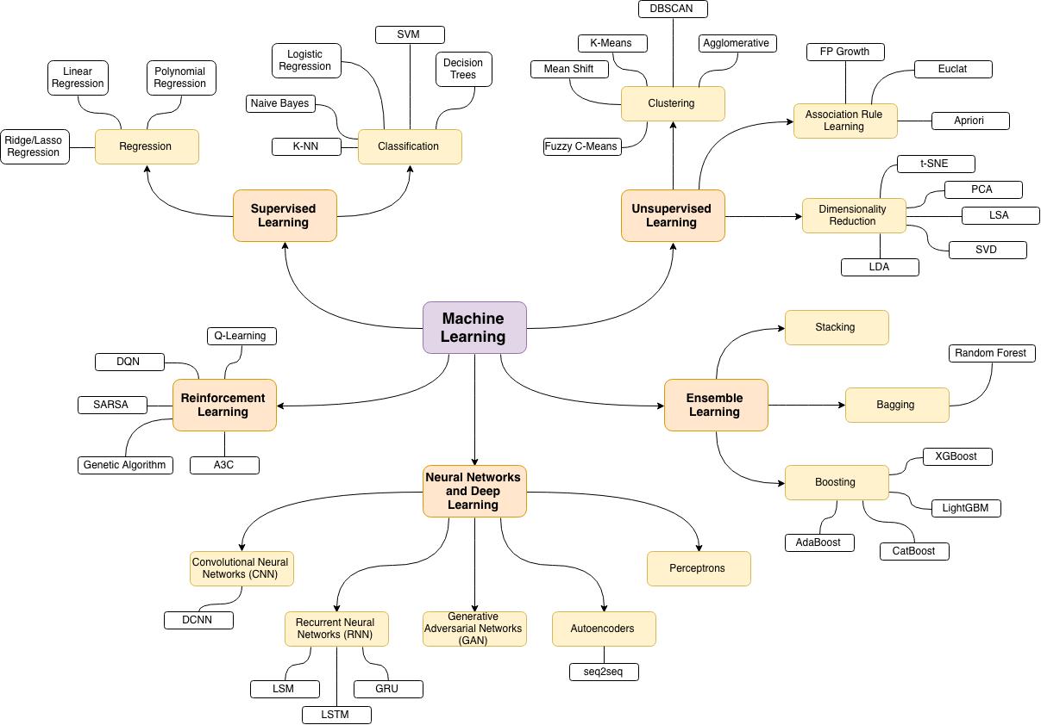
Notes:
Raodmap

Slide 4
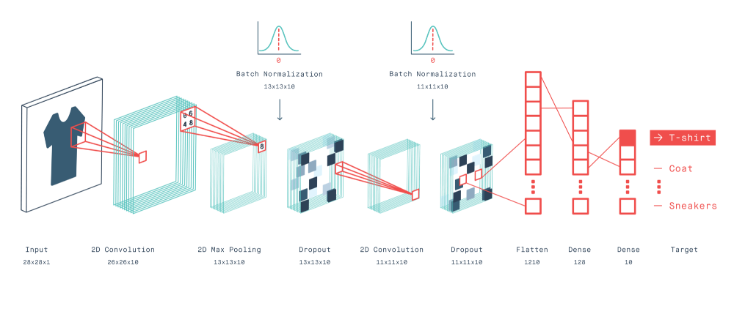
Convolutional Neural Network
convolutional neural network

Slide 5
Adapting Computer Vision models with your own data Transfer learning with Azure Cognitive Services Custom Vision
Notes:
So, now you can see why the Computer Vision API might not be the best choice for
the Shop by Photo feature at Tailwind Traders. In some cases, the vision model
it's using isn't trained to identify the specific products that Tailwind Traders
sells. In other cases, it's been trained to detect *too many* different kinds of
objects, and the wrong one is being found. As you just saw, given a picture of a
drill, it gave us back the tag of "camera", a product that Tailwind Traders
doesn't sell.
Fortunately, we can fix that problem. Let's dive back into the theory for a moment.
What if I told you there's a way to start with a vision model that's been
pre-trained to identify many thousands of images, and adapt it to identify just
the objects you're interested in -- even if those objects weren't part of the
training data for the original model! That sounds strange, I know, but let's see
how it might work.

Slide 6
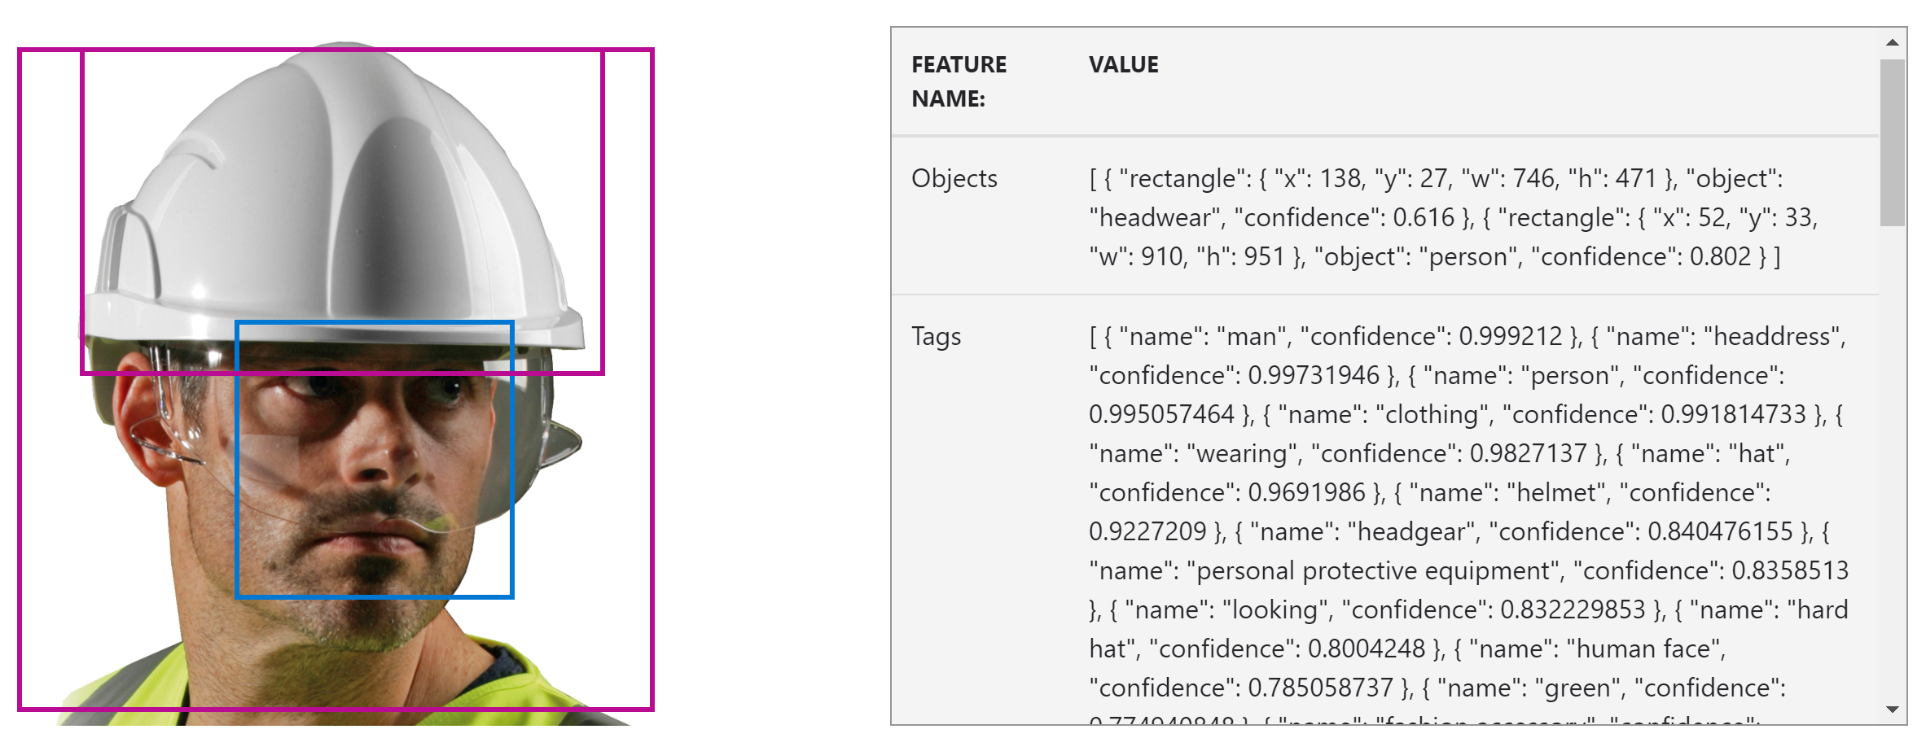
Cognitive Services Computer Vision
Notes:
We can see here in the Objects section of the output that two objects have been
detected in the image: some headwear, and a person.
We're more interested in the "tags" section, which provides classifications for
the overall image along with confidence scores. In this case, the classification
with the highest confidence, after "man", is "headdress" which isn't exactly
what we need for the Shop by Photo app: we were looking for "hard hat".
Unfortunately, this API isn't trained to detect hard hats, only helmets, and
that's only the 6th most confident classification here. We'll learn how to fix
that in just a moment.
But if you want to incorporate vision capabilities into an app, rather than
using a web form, you'll want to access the Computer Vision API programatically.
Let's see how.

Slide 7
Transfer Learning
Transfer Learning: Training
Transfer learning is the reuse of a pre-trained model on a new problem. It’s currently very popular in deep learning because it can train deep neural networks with comparatively little data.
This is very useful since most real-world problems typically do not have millions of labelled data points to train such complex models.
With transfer learning, we basically try to exploit what has been learned in one task to improve generalization in another. We transfer the weights that a network has learned at “task A” to a new “task B.”
F8
Notes:
Here we have the trained convolutional neural network from before, but
something's different: the final layer with the object classifications has been
stripped off. What we're left with is the images from the second-last layer. We
can ignore the fact that they are images -- say, 3x3 images -- and just think of
them as data. Now, when we feed an image to the left hand side, instead of
getting confidence scores, we get a collection of arrays, or "features", each
with 9 data points. In this toy network, they are labelled F1, F2, ... up to F8.
Each image you put in on the left side generates a different collection of
features on the right side.
We don't really know what those features *are*, but what we do know is that they
are useful, because they were useful to classify all of the image types the
neural network was *originally* trained for. Who knows: one feature might
represent "greenness", and was useful to classify trees and tennis balls.
Another might count the number of circle-shaped regions in the image, and was
useful in classifying bicycles and traffic lights. The point is: those features
weren't defined in advance: they were _learned_ from the training data, and are
useful for classifying images _in general_.
And here's the trick: we can use those features to classify objects that the
original network wasn't even trained on.

Slide 8
Transfer Learning: VGG16
Transfer Learning: Training
VGG16 is a convolutional neural network model proposed by K. Simonyan and A. Zisserman from the University of Oxford in the paper “Very Deep Convolutional Networks for Large-Scale Image Recognition”.
The model achieves 92.7% top-5 test accuracy in ImageNet, which is a dataset of over 14 million images belonging to 1000 classes. It was one of the famous model submitted to ILSVRC-2014.
It makes the improvement over AlexNet by replacing large kernel-sized filters (11 and 5 in the first and second convolutional layer, respectively) with multiple 3×3 kernel-sized filters one after another. VGG16 was trained for weeks and was using NVIDIA Titan Black GPU’s.
F8
Notes:
Here we have the trained convolutional neural network from before, but
something's different: the final layer with the object classifications has been
stripped off. What we're left with is the images from the second-last layer. We
can ignore the fact that they are images -- say, 3x3 images -- and just think of
them as data. Now, when we feed an image to the left hand side, instead of
getting confidence scores, we get a collection of arrays, or "features", each
with 9 data points. In this toy network, they are labelled F1, F2, ... up to F8.
Each image you put in on the left side generates a different collection of
features on the right side.
We don't really know what those features *are*, but what we do know is that they
are useful, because they were useful to classify all of the image types the
neural network was *originally* trained for. Who knows: one feature might
represent "greenness", and was useful to classify trees and tennis balls.
Another might count the number of circle-shaped regions in the image, and was
useful in classifying bicycles and traffic lights. The point is: those features
weren't defined in advance: they were _learned_ from the training data, and are
useful for classifying images _in general_.
And here's the trick: we can use those features to classify objects that the
original network wasn't even trained on.

Slide 9

Transfer Learning: Training
VGG16
F8
Notes:
Here we have the trained convolutional neural network from before, but
something's different: the final layer with the object classifications has been
stripped off. What we're left with is the images from the second-last layer. We
can ignore the fact that they are images -- say, 3x3 images -- and just think of
them as data. Now, when we feed an image to the left hand side, instead of
getting confidence scores, we get a collection of arrays, or "features", each
with 9 data points. In this toy network, they are labelled F1, F2, ... up to F8.
Each image you put in on the left side generates a different collection of
features on the right side.
We don't really know what those features *are*, but what we do know is that they
are useful, because they were useful to classify all of the image types the
neural network was *originally* trained for. Who knows: one feature might
represent "greenness", and was useful to classify trees and tennis balls.
Another might count the number of circle-shaped regions in the image, and was
useful in classifying bicycles and traffic lights. The point is: those features
weren't defined in advance: they were _learned_ from the training data, and are
useful for classifying images _in general_.
And here's the trick: we can use those features to classify objects that the
original network wasn't even trained on.

Slide 10
Transfer Learning
F1
F2
F3
F4
F5
F6
F7
F8
Notes:
Here we have the trained convolutional neural network from before, but
something's different: the final layer with the object classifications has been
stripped off. What we're left with is the images from the second-last layer. We
can ignore the fact that they are images -- say, 3x3 images -- and just think of
them as data. Now, when we feed an image to the left hand side, instead of
getting confidence scores, we get a collection of arrays, or "features", each
with 9 data points. In this toy network, they are labelled F1, F2, ... up to F8.
Each image you put in on the left side generates a different collection of
features on the right side.
We don't really know what those features *are*, but what we do know is that they
are useful, because they were useful to classify all of the image types the
neural network was *originally* trained for. Who knows: one feature might
represent "greenness", and was useful to classify trees and tennis balls.
Another might count the number of circle-shaped regions in the image, and was
useful in classifying bicycles and traffic lights. The point is: those features
weren't defined in advance: they were _learned_ from the training data, and are
useful for classifying images _in general_.
And here's the trick: we can use those features to classify objects that the
original network wasn't even trained on.

Slide 11
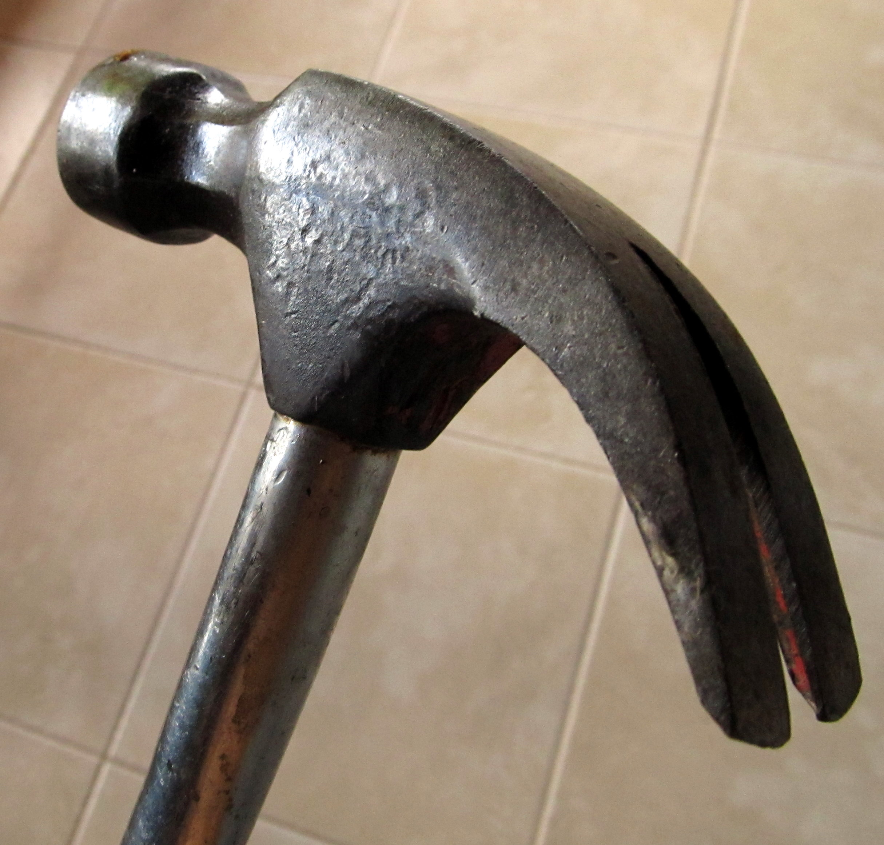
Transfer Learning: Training
F1
F2
F3
hammer
F4
1
hard hat
F5
0
F6
F7
F8
Notes:
Let's suppose we want a new model to identify hammers and hard hats. We can pass an images of a hammer on the left, and collect the features on the right. In this case, we get 8 data vectors (one for each feature), and a binary indicator of the object type. We can repeat that for several different pictures of a hammer, and collect the data vectors and the binary indicator each time.

Slide 12

Transfer Learning: Training
F1
F2
F3
hammer
F4
0
hard hat
F5
1
F6
F7
F8
Notes:
Now let's do the same with pictures of hard hats. Again, in each case, we collect 8 data vectors and a binary indicator for each image.
Put it all together, and what do you have? A collection of data vectors, each with an associated a binary outcome. If you've done any data science, you can guess what happens next: we could build a simple predictive model, like a logistic regression or a one-layer neural network, to predict the new object classifications from the features.

Slide 13
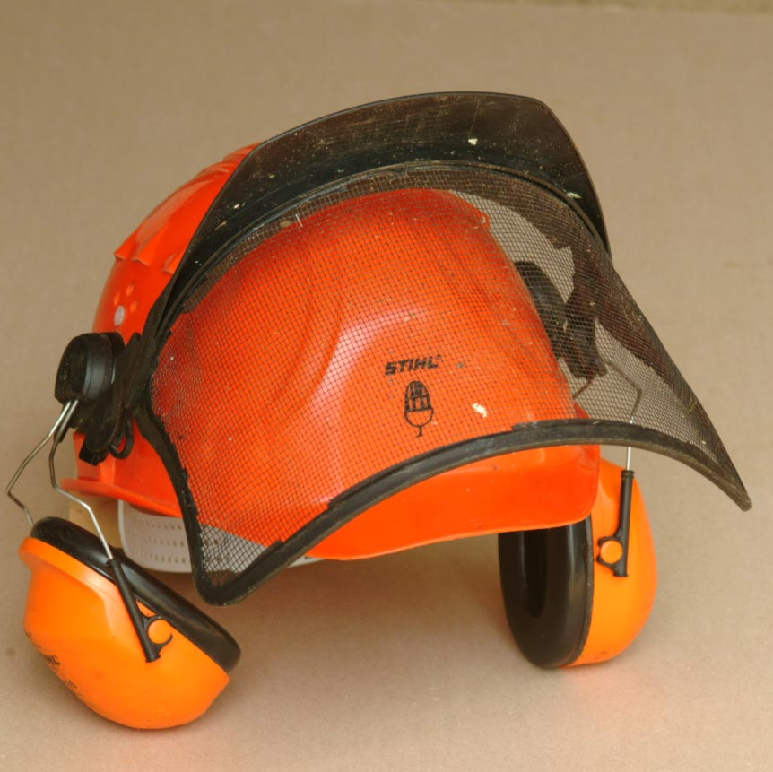
Transfer Learning: Trained Model
F1
F2
F3
hammer
F4
0.10
hard hat
F5
0.87
F6
F7
F8
Notes:
It turns out, this often works surprisingly well. You don't even need a lot of data -- a few dozen images will often do the trick, as long as the categories you want to predict are fairly distinct. And you don't need a lot of computing power to predict a hundred or so binary outcomes from a relatively small amount of data.
Of course, this is a toy example: you will likely want to identify more than two objects, and the underlying neural network will certainly generate many more than 8 features at its second-to-last-layer. But the principle remains: you can do this with modest new data and computing power, and it often works really well.

Slide 14
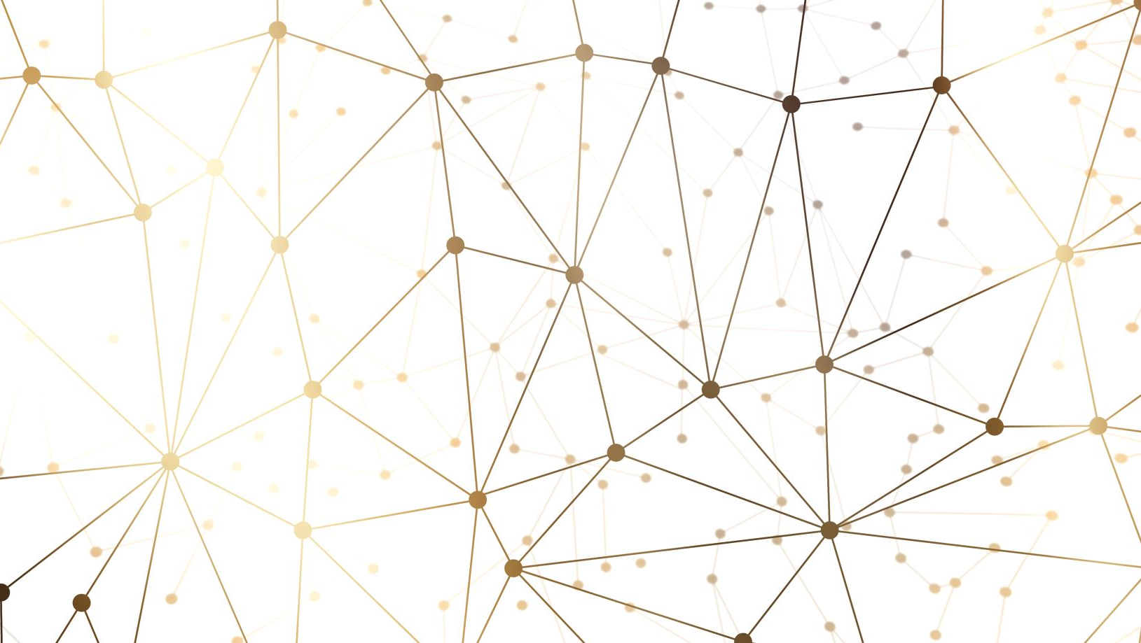
gColab Time ☺

Slide 15
Kahoot Time ☺

